Slide 1
Intro to Infosec History and Hacking culture
Joe Partlow, CTO, ReliaQuest

Slide 2
My background
I have been in the IT and information Security industry for about 20 years and have had experience in Operations Management, Information Security, Network Security, Systems Design, Risk Assessment, Database Administration, Network Infrastructure, Web Application Development, Forensics, Systems Design & Integration and Project Management.
Been fortunate enough to have been part of most every era and shift in information security

Slide 3
Hacker defined - Wikipedia
In the computer security context, a hacker is someone who seeks and exploits weaknesses in a computer system or computer network. Hackers may be motivated by a multitude of reasons, such as profit, protest, challenge, enjoyment or to evaluate those weaknesses to assist in removing them. The subculture that has evolved around hackers is often referred to as the computer underground.
There is a longstanding controversy about the term's true meaning. In this controversy, the term hacker is reclaimed by computer programmers who argue that it refers simply to someone with an advanced understanding of computers and computer networks, and that cracker is the more appropriate term for those who break into computers, whether computer criminal (black hats) or computer security expert (white hats) - but the black-hat meaning still prevails among the general public.

Slide 4
The hacker manifesto
Written by “The Mentor” and published in phrack magazine January 8, 1986
This is our world now... the world of the electron and the switch, the beauty of the baud. We make use of a service already existing without paying for what could be dirt-cheap if it wasn't run by profiteering gluttons, and you call us criminals. We explore... and you call us criminals. We seek after knowledge... and you call us criminals. We exist without skin color, without nationality, without religious bias... and you call us criminals. You build atomic bombs, you wage wars, you murder, cheat, and lie to us and try to make us believe it's for our own good, yet we're the criminals. Yes, I am a criminal. My crime is that of curiosity. My crime is that of judging people by what they say and think, not what they look like. My crime is that of outsmarting you, something that you will never forgive me for. I am a hacker, and this is my manifesto. You may stop this individual, but you can't stop us all... after all, we're all alike.

Slide 5
What’s with the hats?
All “Hats” have extensive knowledge about breaking into computer networks and bypassing security controls. They are also capable of writing exploits, malware and cracking passwords, hashes and other encryption
There are two main factors that determine the type of hacker you’re dealing with: their motivations, and whether or not they are breaking the law:
Black Hat – Someone that does illegal hacking activities (breaks the laws) for maliciousness purposes or personal gain. Motivations can span from financial gain, cyber espionage, protest, or disruption or destruction
White Hat (aka Ethical Hackers)– Infosec professionals using their powers for “good”. Use the same techniques as Black Hats with one exception: they do so with permission of the owner, thus completely legal.
Gray Hat – Most do not have malicious intent, but may conduct unethical or technically illegal activities (e.g. hack a security system without permission)
Example: disclose flaws publically instead of privately or solicit $$ for revealing the flaw privately – wont typically use flaw for “harm”

Slide 6
Definitions continued…
Carders – Hackers that steal and deal in stolen credit cards and/or identities
Hacktivists – Hacking for a cause (social or political)
Bot – software that performs automated tasks on a host or hosts (botnet)
Phreaker – Hacker that specialized in phone systems
Lulz – Doing something for the fun of it (usually mischievous)
Leet speak – Th3 ac7 0f 5wapp1ng numb3r5 f0r l3773r5
n00b – Person new to Infosec or a particular technology
Doxing – Revealing someone’s anonymous online identity
Script Kiddie – Hacker with little or no actual technical skills and just uses tools written by others
Zero Day or O-Day – An exploit against an previously unknown vulnerability

Slide 7
Many specialties out there
Remember there are many different types of hackers and people specialize in various/multiple things:
Social Engineering – manipulating the human
Malware writers – Also write frameworks to make your own variants
Firmware – embedded or hardware level hacking
Web or Mobile applications
Network Infrastructure
Server and Workstation
Wireless

Slide 8
The golden age (pre 2002)
Early on, hacking was mostly done for the fun of it or for bragging rights.
Capt’n Crunch - 70s Phone phreaker used a Capt’n Crunch toy whistle to make free phone calls
Robert Morris worm – First internet worm in 1988 that infected 6000 machines
Computer Fraud Abuse Act in 1986 – First real federal law for hacking
Kevin Poulsen wins a Porsche in 1990 by taking over the phones lines, then blocks phone calls during Unsolved Mysteries special
I Love You/Melissa Virus – First widespread PC viruses that hit in 1999
Kevin Mitnik – First notorious hacker. Held for 4 years in jail starting in 1995 without charges.

Slide 9
The golden age – Cont.
Organized hacking groups on the rise – Cult of the Dead Cow, The L0pht, CCC, 2600, Phrack, Legion of Doom, Master of Deception. The L0pht told Congress in 1998 it could take down the entire internet in 30 minutes
DeCSS – DVD encryption method cracked in 1999, publicized the value of encryption
Mafiaboy – First widespread Denial of Service attacks bringing down CNN, eBay, Yahoo in early 2000
Dmitry Skylarov arrested at Defcon in 2001, first major use of the DMCA
Massive web defacements against security companies by Fluffi Bunni starting in 2000, leader later arrested during Infosec London 2003.

Slide 10
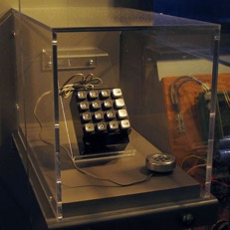
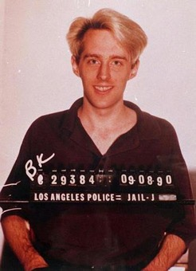
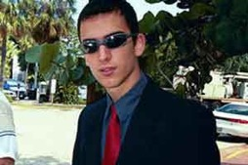
The golden age (pre 2002) – Cont.

Slide 11
The Turning Point – 2001
One of the worst tragedies to happen to the US, 9/11 also had the side effect of changing hacking and information security forever.
Patriot Act – Hacking is an act of terror and expanded the CFAA to include ISPs. Unfortunate side effect of pushing most researchers underground due to fear of prosecution
Code Red/Slammer – Major exploits targeting enterprise software in 2001/2003, businesses started realizing the extent of damage that could be done.
Rise of State sponsored hacking – China, Romania, Russia (RBN). North Korea admits to training hackers.

Slide 12
Hacking goes mainstream (2002-2013)
Enron started the need for corporate awareness for accounting (and security) and many compliance regulations were created to start to do something about the growing problem. Real money involved with hacking/spamming instead of jokes and bragging rights.
PCI, Sarbanes-Oxley, HIPAA and others put in place but lacked real direction and repercussions.
Paris Hilton’s T-Mobile Sidekick hacked in 2005, bringing hacking to the general public
Rise and success of Hacktivism – Anonymous, Lulzsec, AntiSec showed that hacking for a common purpose works (for good and bad)
Albert Gonzalez hacks TJX in major data breach announced in 2007, received 20 years in prison

Slide 13
Hacking goes mainstream – Cont.
Conficker Worm runs through millions of PCs in 2009
Stuxnet hits in 2010 and brought awareness to vulnerabilities in SCADA systems. Doubts on nation states behind Iranian nuclear targets
Social Engineering start to become mainstream in 2011 - RSA social engineering), HBGary Federal (social engineering) hacks were devastating
Sony – First compromised via injection attack in 2011, worst case scenario of playstation network going down for 20 days and huge breach of 77 million accounts
Wikileaks explodes in 2010 after Bradley (Chelsea) Manning leaks Army documents
Hector “Sabu” Monsegur led authorities in 2012 to charge Lulzsec members

Slide 14
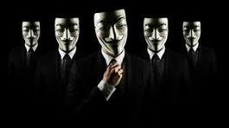
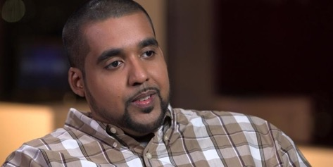
Hacking goes mainstream – Cont.

Slide 15
Do or die (2013 - Present)
The Target hack in 2013 brought the end to the compliance era by finally getting through to execs that compliance does not equal secure
Offensive teams are overwhelmed, not enough talent to go around
Large scale breaches due to IT/security teams not able to keep up with large, distributed environments
Snowden brings data privacy mainstream in 2013 with NSA leaks
Massive Breaches happen 2014-2015 and changes the mindset to ”when, not if” you will bet breached. Home Depot, Staples, Sony Pictures, OPM, Anthem, Ashley Madison
Mt. Gox bitcoin exchange loses $460M – Goes bankrupt
Chinese Apt 18 hacking group uses 2014 Heartbleed bug to steal health records
Internet of Things – More things to hack!

Slide 16
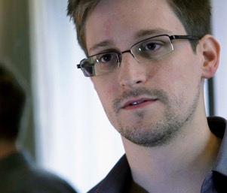
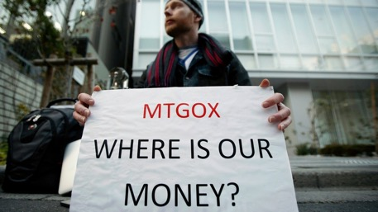
Do or die – Cont.

Slide 17
Hacking Culture – TV, books & movies
Bladerunner
Tron (old and new)
The Matrix Series
Ghost in the Shell
Strange Days
Johnny Mnemonic
Wargames
Hackers
Sneakers
Die Hard 4
The Net
AntiTrust
Takedown
Who am I
Swordfish
Mr. Robot
Phrack (http://www.phrack.org)
2600 (http://www.2600.org )
Snow Crash (Neal Stephenson)
Neuromancer (William Gibson)
The Cuckoo’s Egg

Slide 18
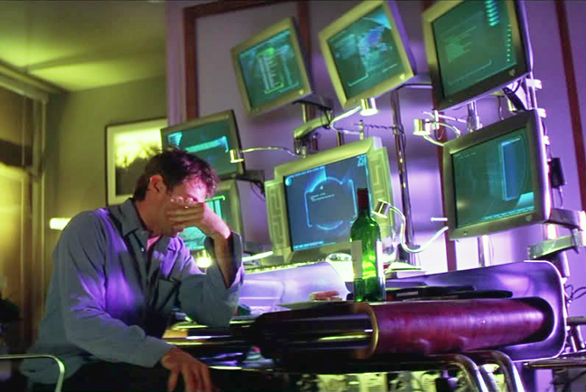

Movie Hacking – lots of virtual reality

Slide 19
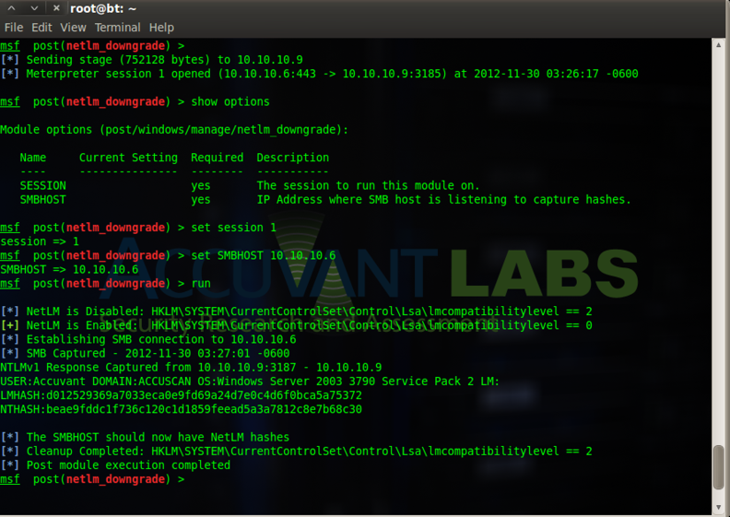
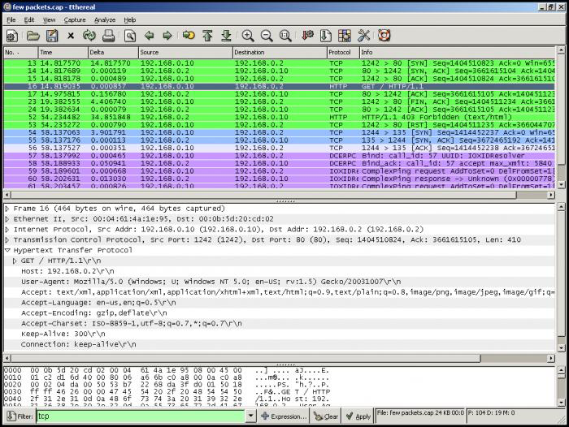
Real Life Hacking – not very fun to watch

Slide 20
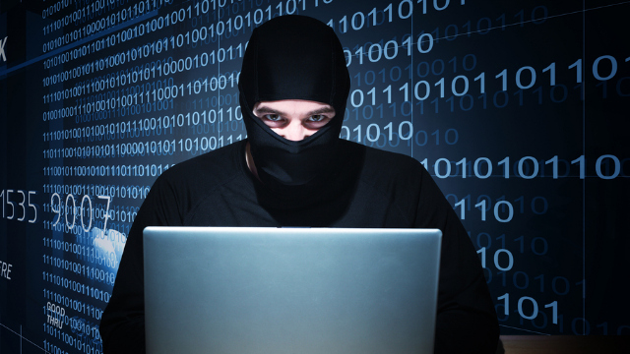
Not a hacker – masks are too hot!

Slide 21
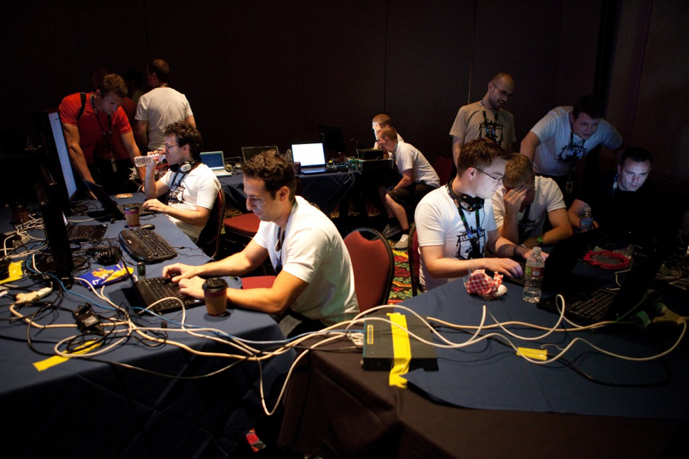
Hackers – real life ctf hacking

Slide 22
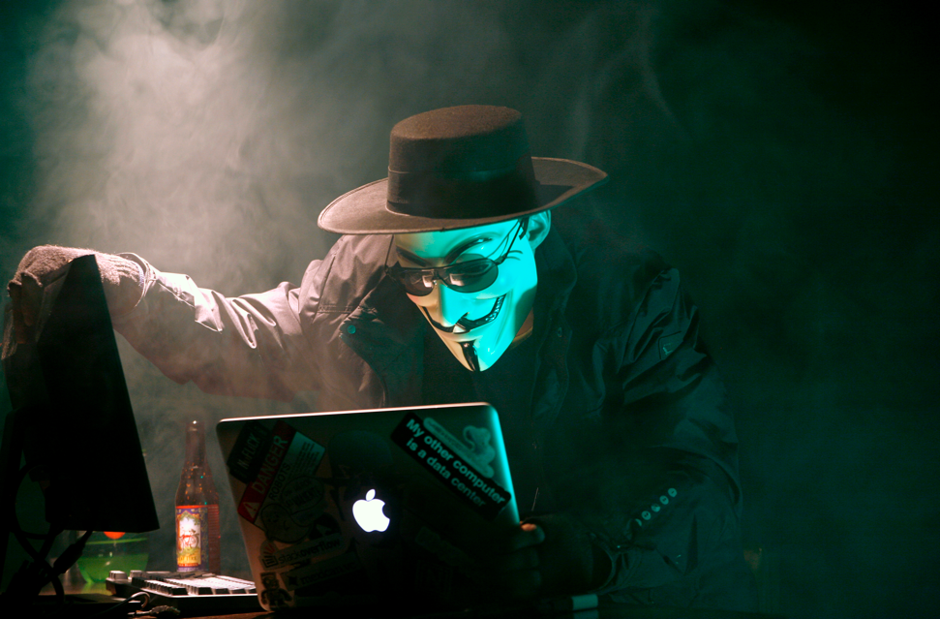
Not a hacker – your laptop is on fire!

Slide 23
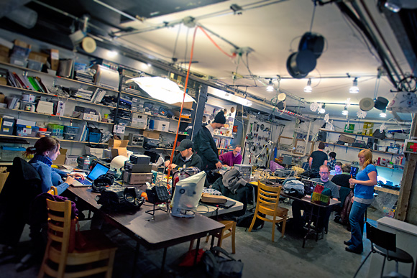
Hackers – we love stuff (Ie. Dave’s desk)

Slide 24
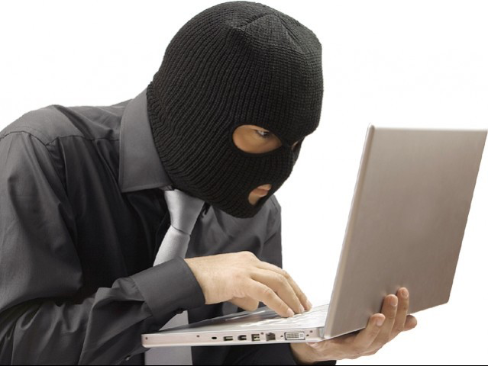
Not a hacker – who types like that???

Slide 25
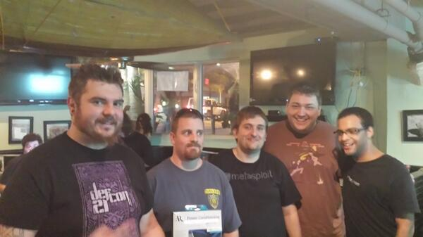
Hackers – some may not be sober…

Slide 26
Job Prospects
Great opportunity! Negative unemployment!
Every customer we deal with (including us) needs more security people.
Need good communication skills, not only for hard core techie people.
Good salary and opportunity to learn many different areas.
Get paid to break into things all day!

Slide 27
How can I be 1337 also?
If you feel like you know everything, then you aren’t trying hard enough!
Always be learning and teaching. This truly is the coolest area of computing
Get involved – Get involved with the community and friends. Start a student group…
Use Twitter – Hear about the latest hacks days before most news sites or even the target finds out. W00T!!!
Build a lab – Virtualbox to build your own attack and defense scenarios to practice on.
Don’t be afraid of the CTF – Best way to learn information security is to do it. Defend your own network and servers, all while trying to attack others and getting annihilated in the process (FUN!). Many online CTFs available.

Slide 28
Sites to get more info
http://vulnhub.com
http://forensicscontest.com
http://securitytube.net
http://www.offensive-security.com/metasploit-unleashed/Main_Page
http://websec.ca/kb/sql_injection
http://threatpost.com
http://darkreading.com

Slide 29
COnferences
Defcon – Started by Jeff Moss (Dark Tangent) & held every year in Vegas, it’s the largest and oldest con. Started in 1993 as a party in Vegas for a few friends
Blackhat – Every in Vegas, Asia, DC, etc. Started as a commercial or more corporate alternative to Defcon about 15 years ago by the same founder.
B-Sides – Started in Vegas as an overflow for all the good talks that couldn’t fit in during Defcon weekend. Currently held in most major cities and in other countries.
DerbyCon – Started about 6 years in Ky, as an alternative to Defcon going ”mainstream”
Shmoocon – Held every year in DC. Extremely limited tickets (sells out in seconds) in order to keep it exclusive
HOPE – Held every couple years in New York (if they happen to feel like it)
Circle City Con – Just started in Indianapolis, up and coming as the new Derbycon?
Visit Irongeek.com & securitytube.net for tons of recorded conference talks

Slide 30
Thank You
Remember - Jail sucks
With great power comes great responsibility.
You don’t hack a bank across state lines! Felony hacking charges cut your career pretty short and could get you labeled as a terrorist…
Practice on your own machines and networks or ones you have WRITTEN permission on!
Questions?

